Slide 1
Project-8
Group 4

Slide 2
Introduction
Project is about normalizing and applying preprocessing techniques on given dataset(the minimum daily temperatures over 10 years (1981-1990) in the city Melbourne, Australia)

Slide 3
Loading of datset
import pandas as pd
df=pd.read_csv('daily-min-temperatures.csv')
df

Slide 4
Printing data in Data set using df.head()
 | Date | Temp
0 | 1981-01-01 | 20.7
1 | 1981-01-02 | 17.9
2 | 1981-01-03 | 18.8
3 | 1981-01-04 | 14.6
4 | 1981-01-05 | 15.8

Slide 5
Preprocessing of data using .info(),.describe()
df.info()
output
<class 'pandas.core.frame.DataFrame'>
RangeIndex: 3650 entries, 0 to 3649
Data columns (total 2 columns):
# Column Non-Null Count Dtype
--- ------ -------------- -----
0 Date 3650 non-null object
1 Temp 3650 non-null float64
dtypes: float64(1), object(1)
memory usage: 57.2+ KB

Slide 6
df.describe()
 | Temp
count | 3650.000000
mean | 11.177753
std | 4.071837
min | 0.000000
25% | 8.300000
50% | 11.000000
75% | 14.000000
max | 26.300000

Slide 7
Prepare data for normalization
values = df["Temp"].values
values = values.reshape((len(values), 1))

Slide 8
Train the normalization
import numpy as np
import pandas as pd
from sklearn.preprocessing import MinMaxScaler
scaler = MinMaxScaler(feature_range=(0, 1))
scaler = scaler.fit(values)
print('Min: %f, Max: %f' % (scaler.data_min_, scaler.data_max_))
Output : Min: 0.000000, Max: 26.300000

Slide 9
Normalize the dataset and print the first 5 rows
normalized = scaler.transform(values)
df1=pd.DataFrame(normalized)
df1.head()

Slide 10
output
 | 0
0 | 0.787072
1 | 0.680608
2 | 0.714829
3 | 0.555133
4 | 0.600760

Slide 11
Plotting the data
plt.plot(df["Date"],df["Temp"])
plt.xlabel("Date")
plt.ylabel("Temp")
plt.title("Daily min Temperatures")
plt.show()

Slide 12
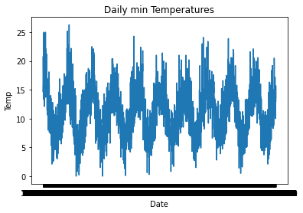

Slide 13
THANK YOU

